Slide 1


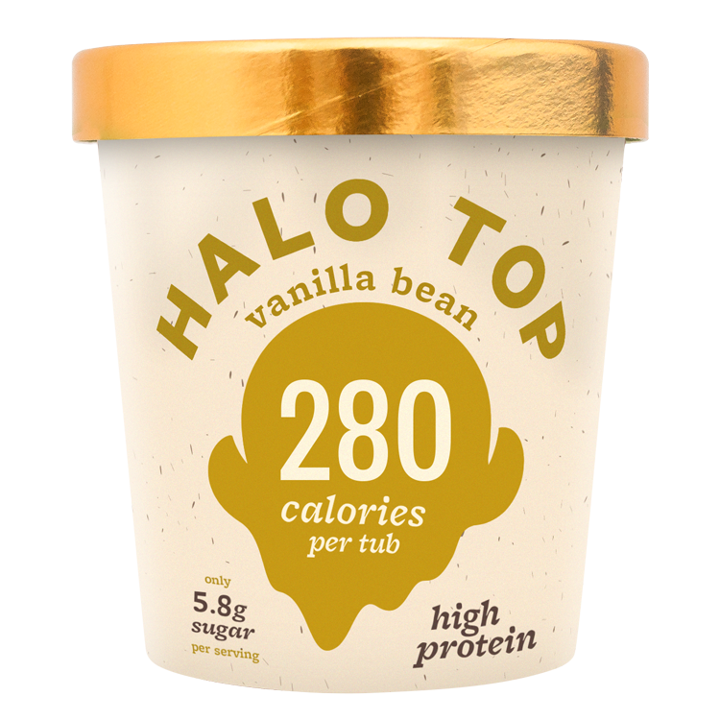

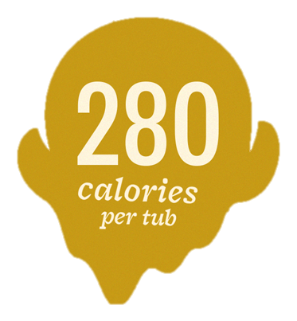
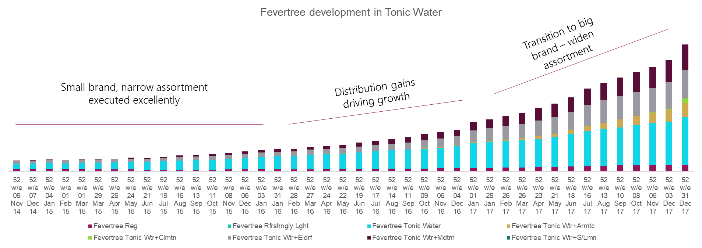
CONSIDERATION
Case studies How to learn from successful brands in similar situations
Drive desire for the brand, grow penetration and target competition
Consideration
Innovation: Ensure you have a unique proposition
Halo top entered the tub ice cream market as a small brand with a very distinctive and unique proposition
Focus on differentiation
Packaging stand-out: Golden top
Concept: Low calorie simplicity
Advertising through Instagram fitness influencers
Assortment: Maintain a narrow range executed excellently
For the first two years of Fevertree’s growth it maintained 4 key products and drove greater distribution. Only once it became a big brand did it start to branch out with its assortment

Slide 2
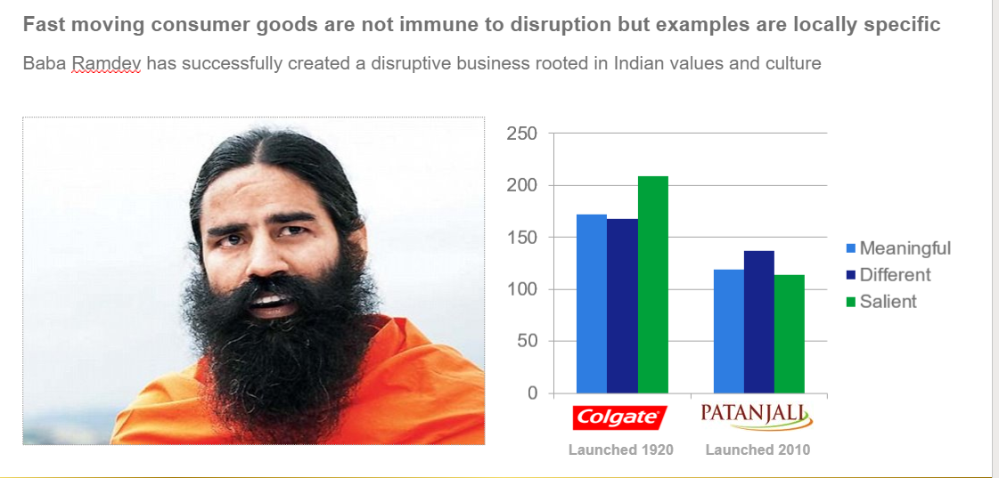

CONSIDERATION
Case studies How to learn from successful brands in similar situations
Drive desire for the brand, grow penetration and target competition
Consideration
Attitudes: Drive desire for brand and category
xx
Advertising: Target category rejecters
Not only has the brand seen a 2% increase in penetration, but has also managed to increase category frequency by 6.5%
(from 3.4 to 3.7)
Wardah, unlocked a new buyer segment in Indonesia, focusing on Halal cosmetics

